Slide 2
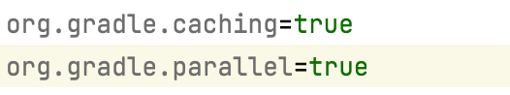
Test Design | Time (second) | Link to the report | Time Saving From
Gradle clean build | 46.553 | https://enterprise-training.gradle.com/s/kaqp3akwvqy6i/timeline | NA
Gradle clean build + Parallel building | 14.792 | https://enterprise-training.gradle.com/s/gz5glkdsra5hu/timeline | running all the 10 tests in parallow
Gradle clean build + build cache | 0.790 | https://enterprise-training.gradle.com/s/tkkgusgoushk6/timeline | directly using all the build cache from the previous build
Maven clean install | 46.864 | NA | NA

Slide 3
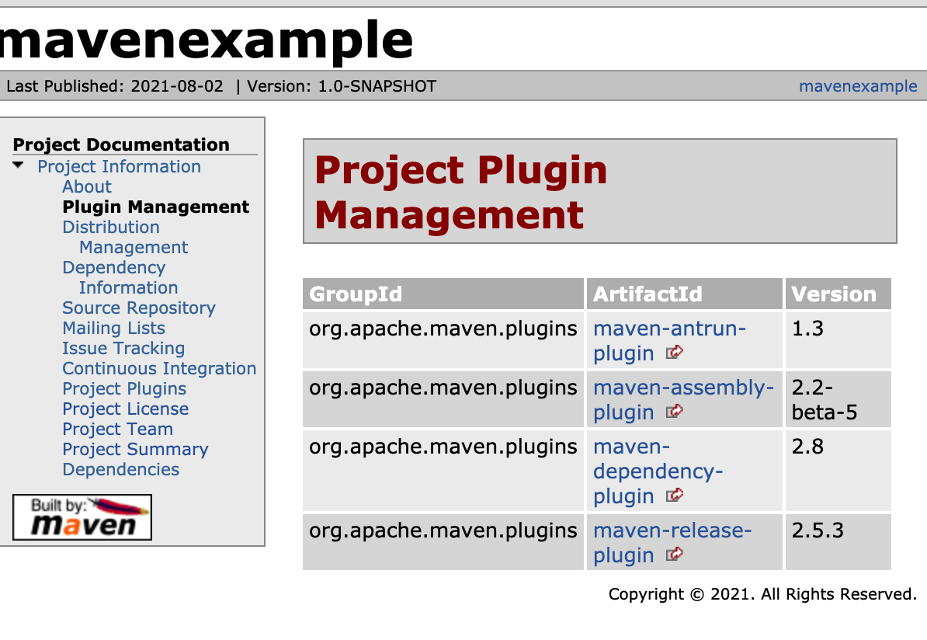
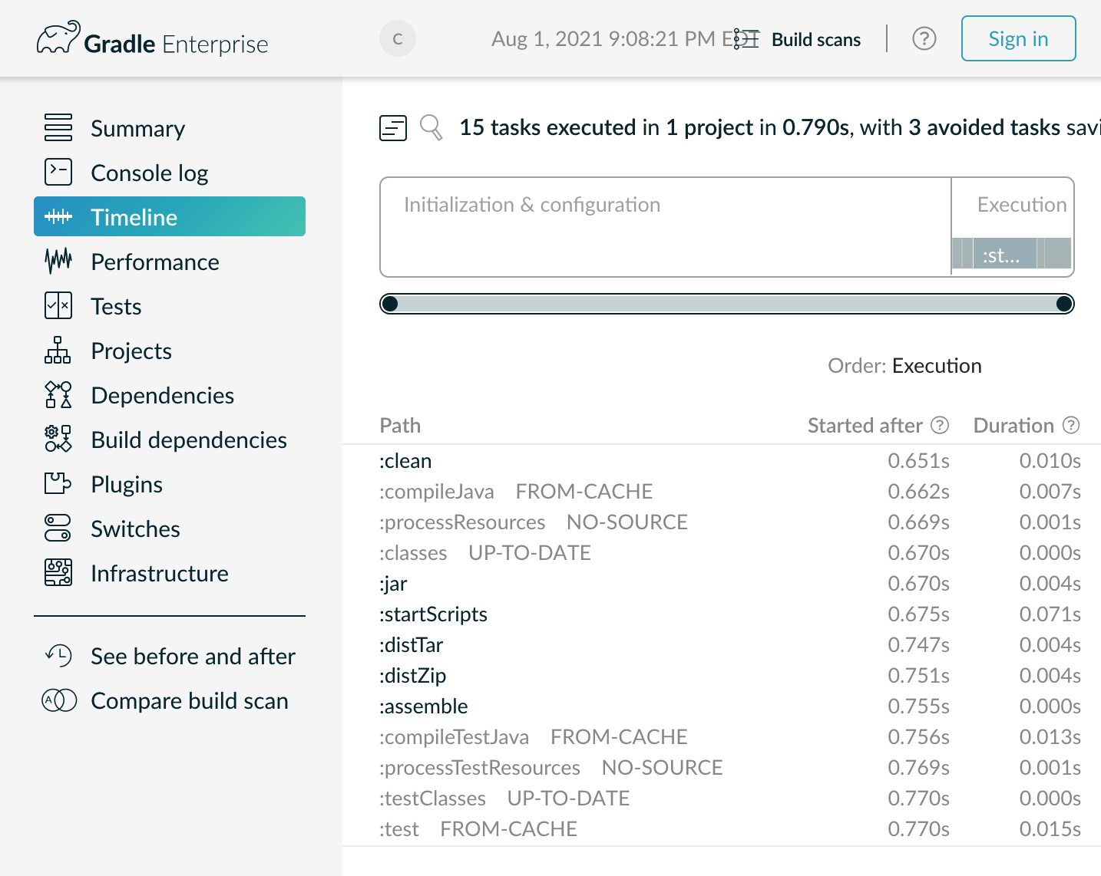

Slide 4
